Slide 1
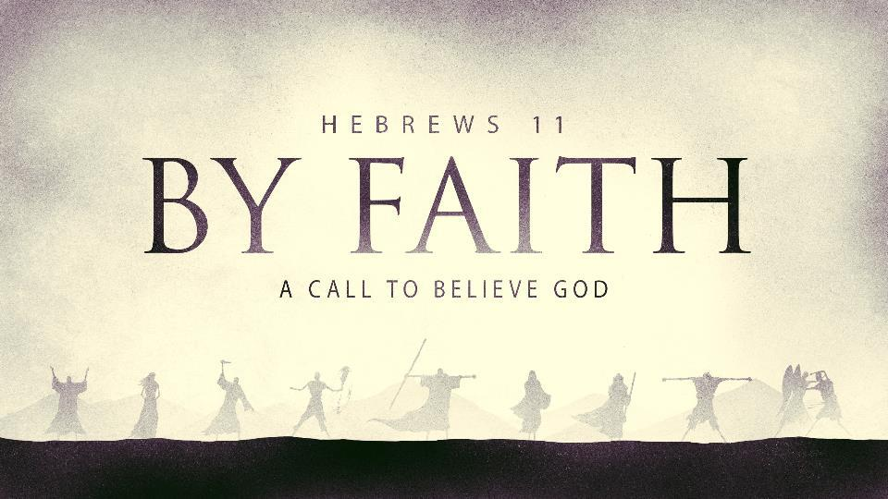

Slide 2
BY FAITH
Those whose FAITH in the Word of God results in a living (lived out) faith:
Find out what God’s Word says about their circumstances and then they trust God to make His promises a reality in their life!

Slide 3
Luke 5:1-7 And it came to pass, that, as the people pressed upon him to hear the word of God, he stood by the lake of Gennesaret, 2 And saw two ships standing by the lake: but the fishermen were gone out of them, and were washing their nets. 3 And he entered into one of the ships, which was Simon's, and prayed him that he would thrust out a little from the land. And he sat down, and taught the people out of the ship. 4 Now when he had left speaking, he said unto Simon, Launch out into the deep, and let down your nets for a draught.

Slide 4
Luke 5:5 And Simon answering said unto him, Master, we have toiled all the night, and have taken nothing: nevertheless at thy word I will let down the net. 6 And when they had this done, they inclosed a great multitude of fishes: and their net brake. 7 And they beckoned unto their partners, which were in the other ship, that they should come and help them. And they came, and filled both the ships, so that they began to sink.

Slide 5
BY FAITH
Those whose FAITH in the Word of God results in a living (lived out) faith:
Find out what God’s Word says about their circumstances and then they trust God to make His promises a reality in their life!
Are ordinary people who are enabled to do extraordinary things by God’s grace thru faith alone!

Slide 6

Faith lives by grace not works

Slide 7
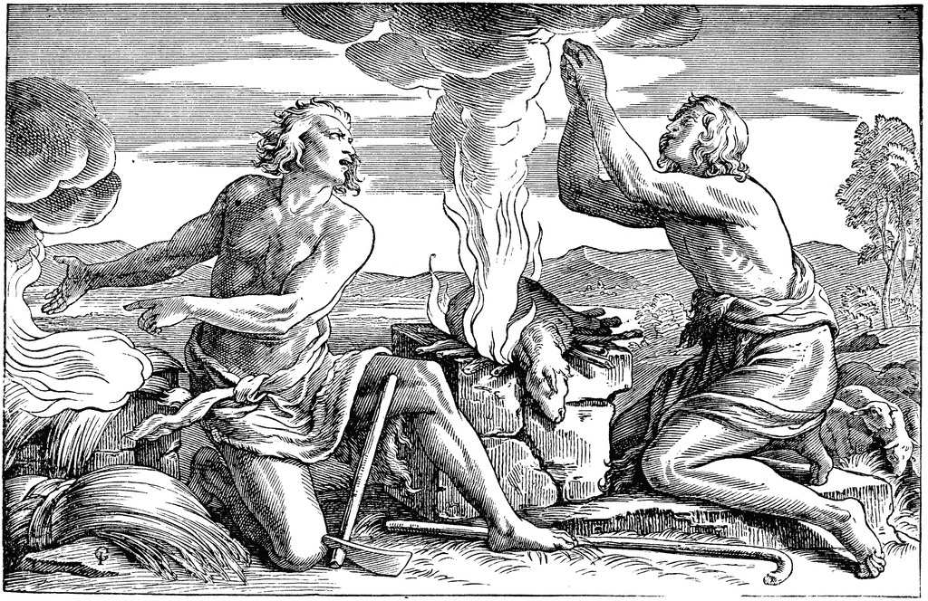
BY FAITH

Slide 8
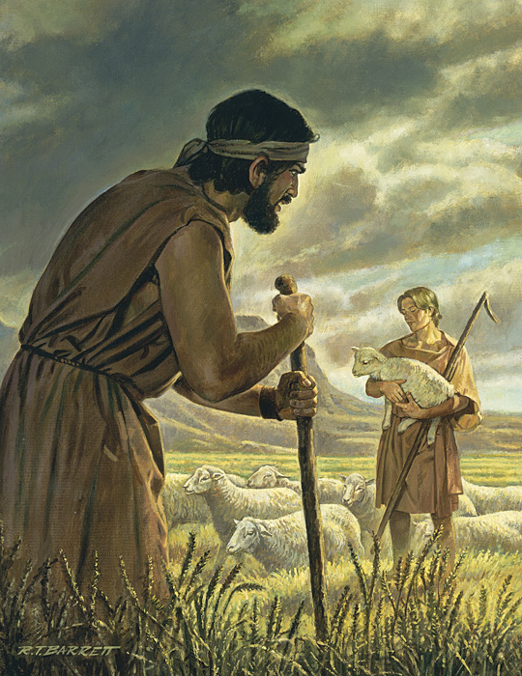
BY FAITH
A more excellent sacrifice!
  Two difference approaches
  to God.
  Cain: Founder of the world’s
  first false religion. (Gen 4:3)
  Able: Found the only way to
  God. Through the shed blood
  of the lamb. (Gen4:4)
  He 9:22b “and without shedding
  of blood is no remission.”

Slide 9
Romans 10:3 For they being ignorant of God's righteousness, and going about to establish their own righteousness, have not submitted themselves unto the righteousness of God.

Slide 10
Point 1: False religion is man trying to come to God through any way that is outside the way God requires.

Slide 11
Point 2: We want to substitute
our WORKS for faith.
then we expect God to accept it.

Slide 12
BY FAITH
Eph 2:8-9 For by grace are ye saved through faith; and that not of yourselves: it is the gift of God: 9 Not of works, lest any man should boast.

Slide 13
Prov 14:12 There is a way which seemeth
right unto a man, but the end thereof are
the ways of death.

Slide 14
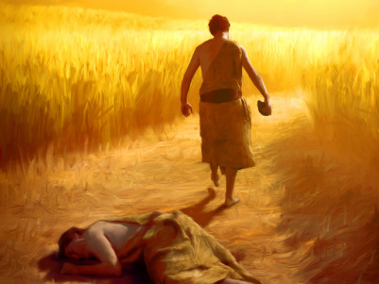
BY FAITH
Result of Cain’s man made religion:
  God does not accept
  our sinful works as
  atonement for our sin.
  Cain was angry and
  depressed.
  Cain murdered in
  pursuit of his religion.
  Cain was lost.
  Cain "went out from the presence of the Lord" (Gen 4:16)

Slide 15
Faith lives by grace not works

