Slide 1
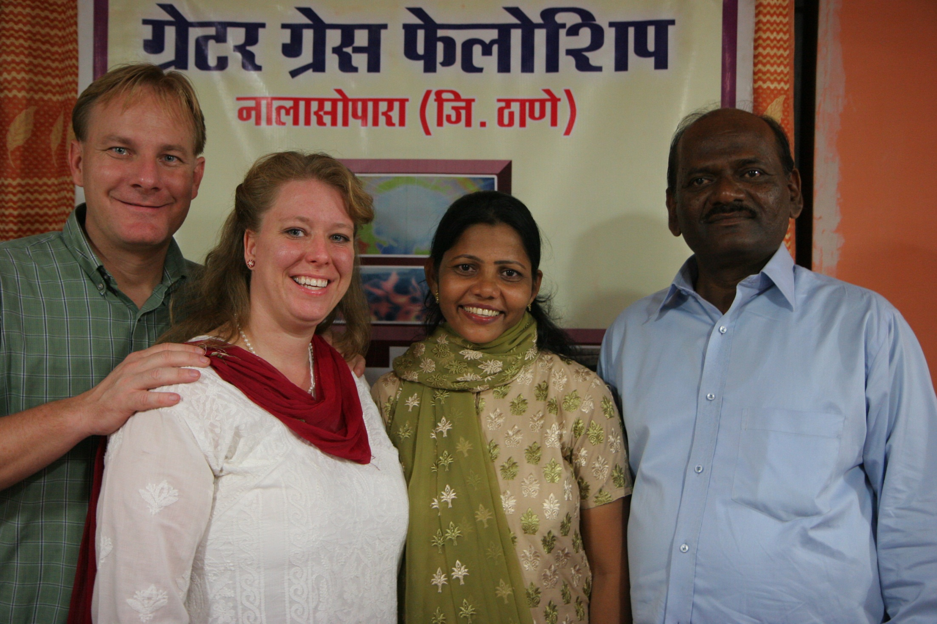

Slide 2
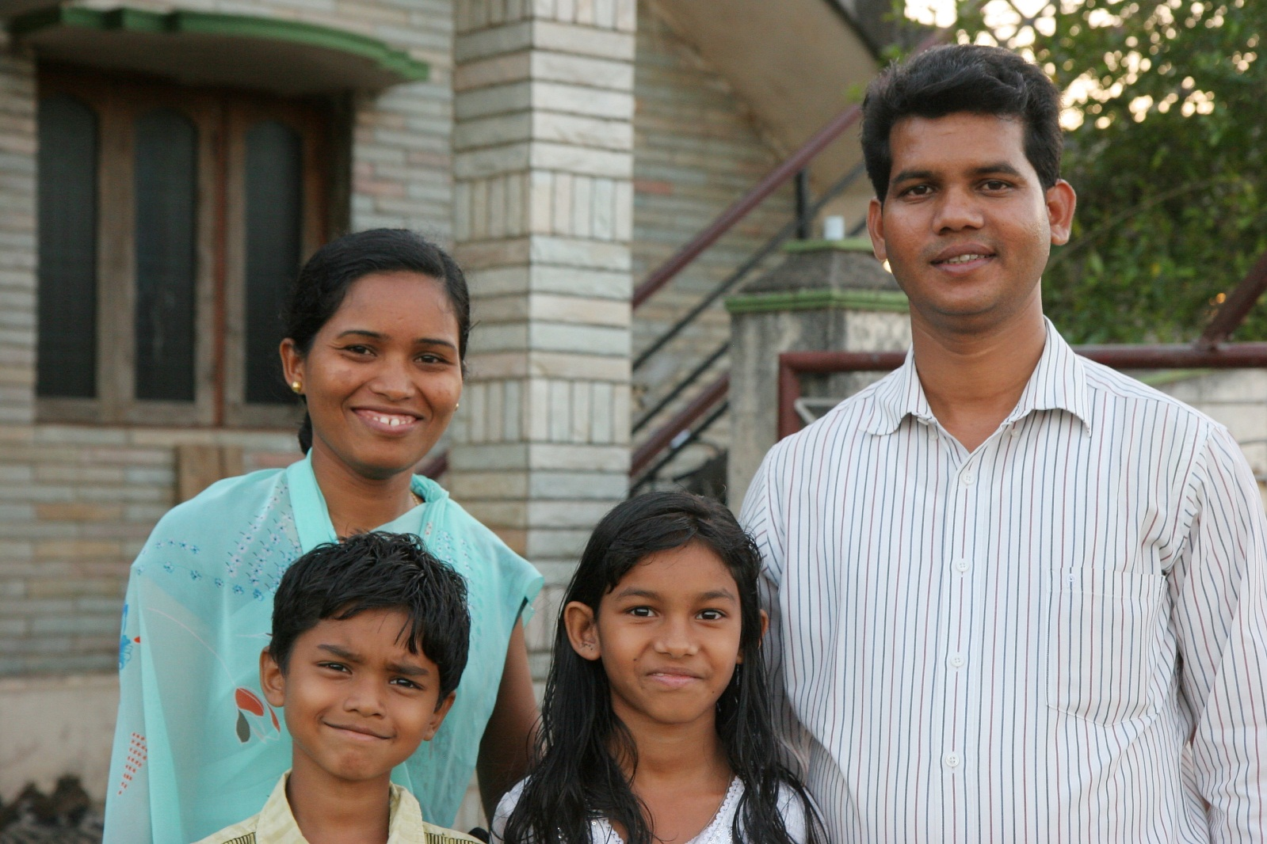

Slide 3
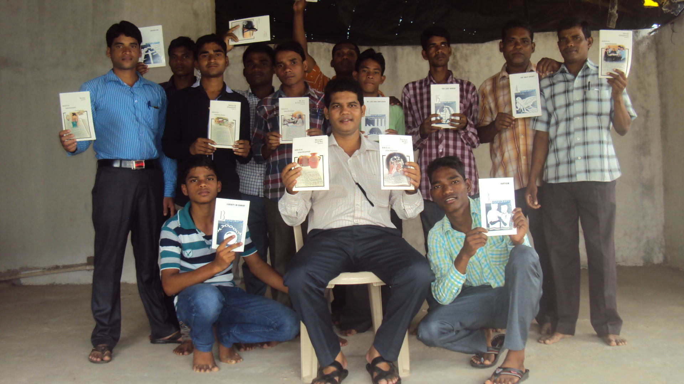

Slide 4
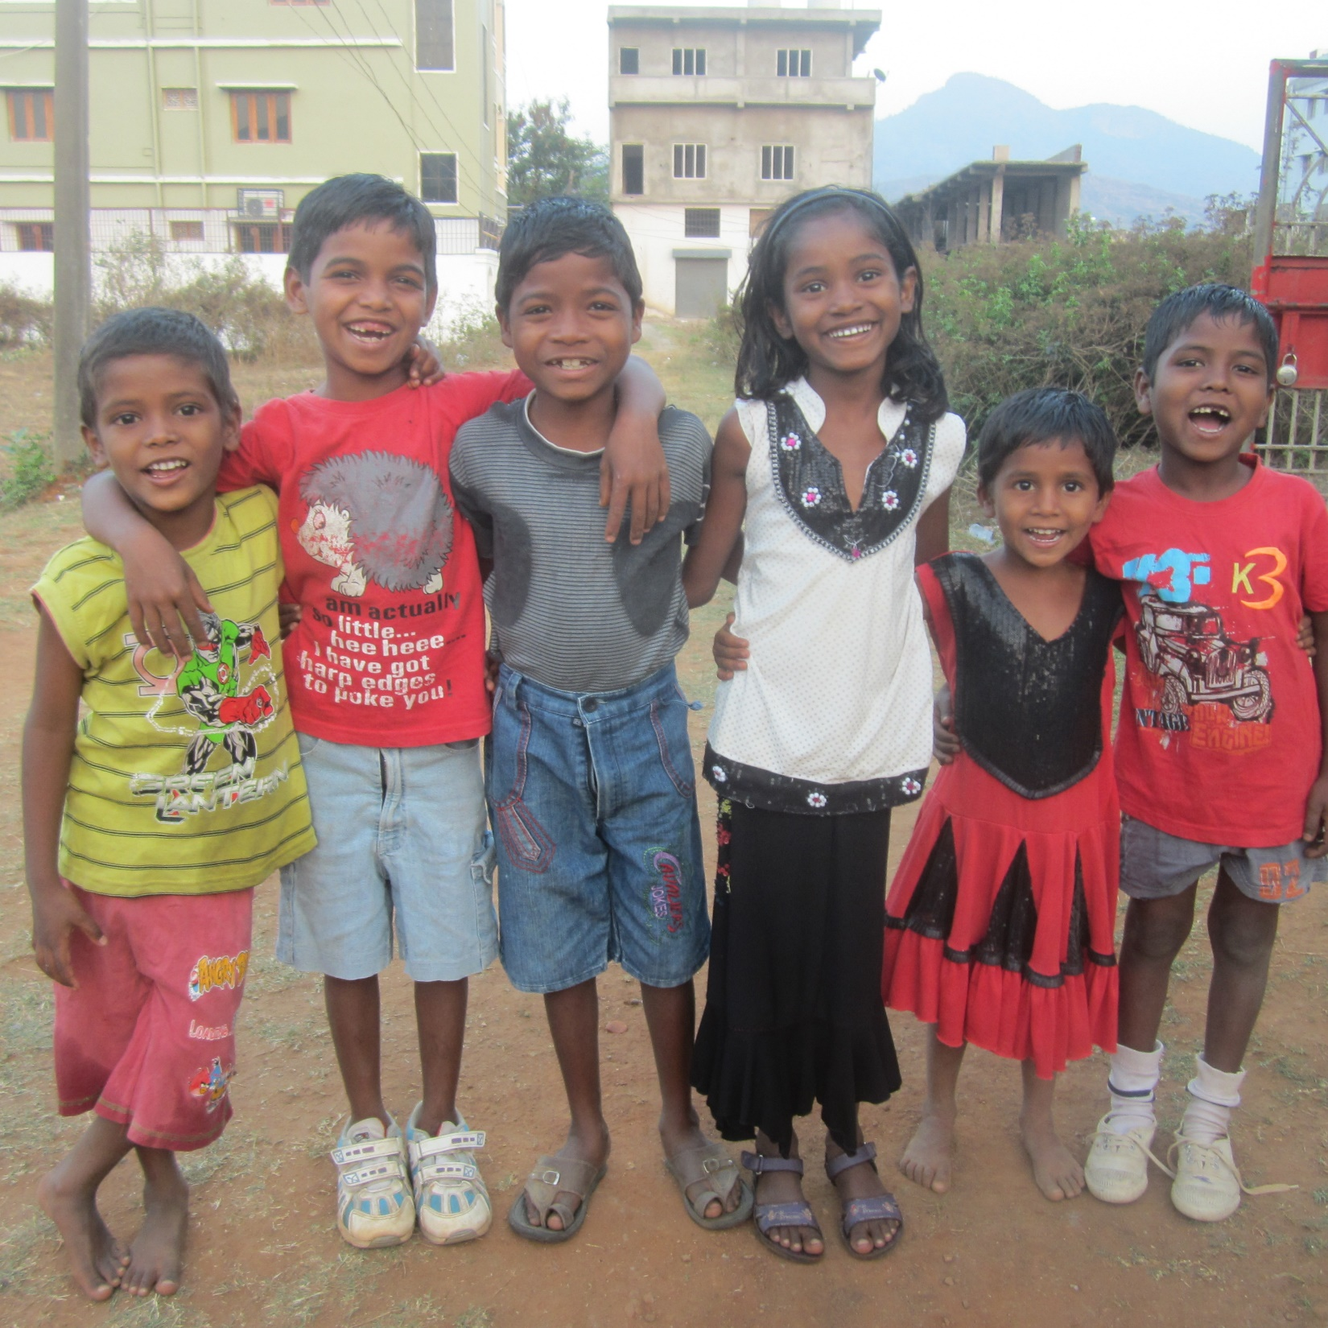

Slide 5
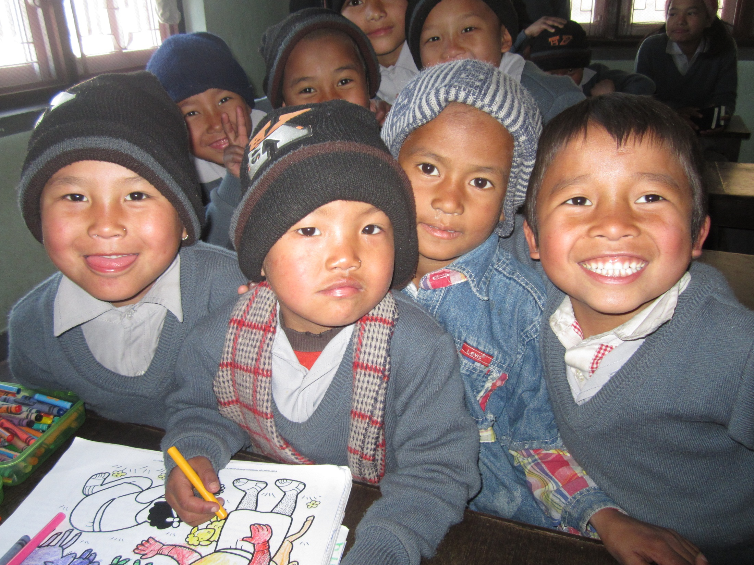

Slide 6
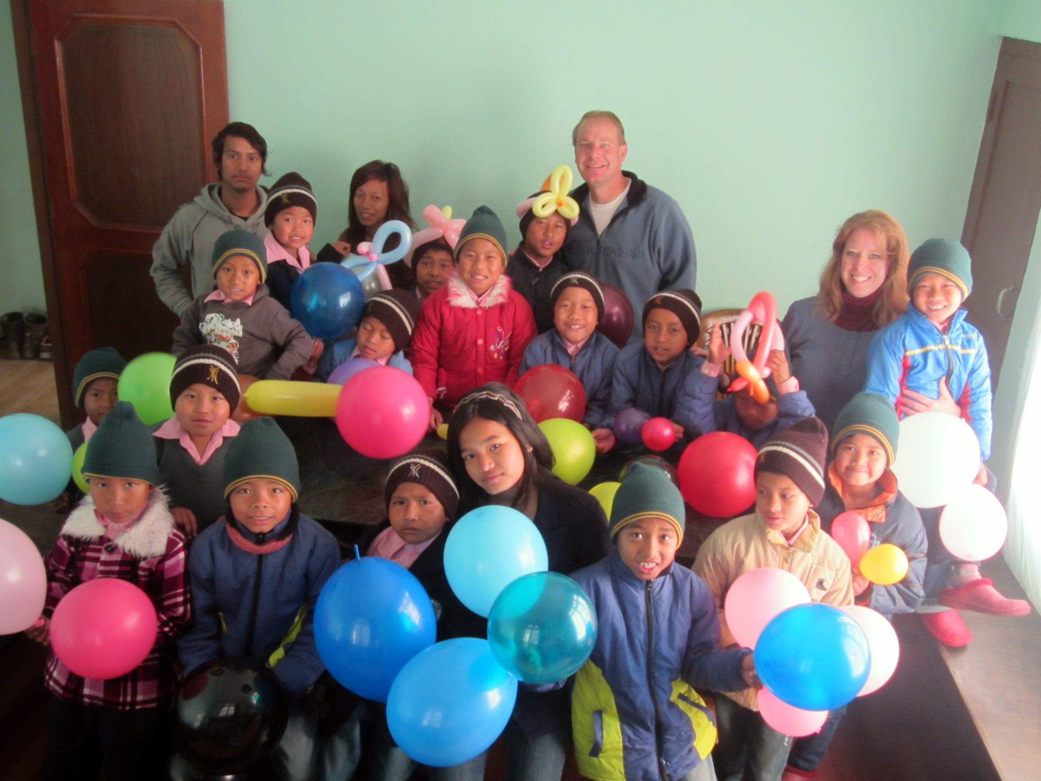

Slide 7
WHAT IS THE PURPOSE OF SUFFERING?
WHY DOES GOD ALLOW SO MUCH EVIL?
God’s original plan was for us to live in a garden of Eden with no thorns and no suffering – Genesis 1-3

Slide 8
Why is their so much suffering??
(1)Free will (2)sin (3)Satan.
FREE WILL WAS A RISK BUT IT IS WORTH THE RISK. WE DON’T WANT TO BE ROBOTS, WE WANT TO HAVE LOVE.

Slide 9
WHAT SUFFERING HAVE YOU GONE THROUGH?
WHAT SUFFERING HAVE YOUR FRIENDS AND FAMILY GONE THROUGH?
SOMETIMES WE SUFFER FROM SELFISH PERCEPTION OF OUR TRIALS. We cannot see the trial as a blessing in disguise.
We may work up negative emotions inside us as a manufactured storm and refuse wisdom and help.
God can heal and change you.
God loves you just as you are. Yet He wants to grow you and change you.
ROMANS 8:28 – LEARN TO TRUST GOD. GET ANGRY AT SATAN.
THE STORY OF JOSEPH IN GEN. 37-50.

Slide 10
DEEP QUESTIONS ABOUT REAL SUFFERING:
Children born with disabilities and those who care for them all their lives.
The death of loved one, traumatic experiences.
Abuse, Divorce, car accidents, Broken relationships and loneliness.
War, cruelty, bombs, political corruption, bribes, and murder.
Hatred of one people against another; Civilians caught up in the middle of wars they did not ask for. Trench warfare that accomplishes nothing but moving the battle lines back and forth.
Greedy elite people controlling the world’s economic system with no plan to stop the oppression of the poor; no care to try to lift up the poorer classes with justice and compassion.
Genocide, terrorism, rapes, and slavery. Poverty and no education.
Disease, famines, earthquakes, tsunamis, and hurricanes wrecking havoc………WHY GOD? WHY? WHY DO YOU ALLOW THESE THINGS? WE KNOW YOU ARE GOOD, BUT WHY??

Slide 11
JESUS KNOWS WHAT YOU HAVE GONE THROUGH.
HEBREWS 4:15-16 “For we have not an high priest which cannot be touched with the feeling of our infirmities; but was in all points tempted like as we are, yet without sin.
¹⁶ Let us therefore come boldly unto the throne of grace, that we may obtain mercy, and find grace to help in time of need.”

Slide 12
EVIL COMES FROM THE MIND OF SATAN, NOT GOD. SATAN WANTS YOU TO GET ANGRY AT GOD FOR WHAT HE DOES.
SATAN IS ON LIMITED TIME. SOON EVIL AND SUFFERING WILL BE REMOVED.
WHAT IS GOD WAITING FOR? 2 PETER 3:9.
GOD WEEPS WITH THOSE WHO WEEP, GOD’S HEART IS ALSO BROKEN;
JESUS WAS A MAN OF SORROWS**HE WALKS AMONG THOSE WHO SUFFER WITH EMPATHETIC LOVE; HE RELIEVES THE PAIN, HE SENDS WORKERS OF HEALING LOVE TO HELP PEOPLE AND TO START CHANGING THINGS.

Slide 13
JESUS SUFFERED EVERY PAIN. HE WAS ABUSED, DISABLED, PARALYZED, HE FACED HORROR, WAS ABANDONED and LONELY; HE POURED OUT HIS LIFE FOR US AND BORE OUR SINS ON THE CROSS.
JESUS ENDURED EXCRUCIATING TORTURE, INJUSTICE AND DEATH; HE FOUGHT A WAR FOR US ON THE CROSS AND WON!! FORGIVENESS AND ETERNAL LIFE IS WON FOR US!!
HEBREWS 12:1-2 “for the joy set before him, he endured the Cross.”
Joni E. Tada’s illustration of being blindfolded and carrying 40 pound bag around as someone directs you where to go.

Slide 14
We want to know God, we want to be like Jesus Christ in loving, wise and holy character. Jesus is our Hero and our God!!
ROMANS 8:16-18 : “The Spirit itself beareth witness with our spirit, that we are the children of God:
¹⁷ And if children, then heirs; heirs of God, and joint-heirs with Christ; if so be that we suffer with him, that we may be also glorified together.
¹⁸ For I reckon that the sufferings of this present time are not worthy to be compared with the glory which shall be revealed in us.”

Slide 15
JESUS CHRIST INTRODUCED SUFFERING AS A PLATFORM FOR TRIUMPH!!
WE NEED A MIND TO SUFFER. 1 PETER 4:1 “Forasmuch then as Christ hath suffered for us in the flesh, arm yourselves likewise with the same mind:”
SO THAT WE ARE READY TO LIVE IN JOY TO THE GLORY OF GOD.
SO THAT WE CAN FULFILL OUR PURPOSE OF WHY GOD CREATED US.
SO THAT WE DO NOT LIVE A SHALLOW LIFE.
SO THAT WE MIGHT BE A BLESSING TO OTHERS AND NOT BE SO BITTER. So we can reach others with the gospel.

Slide 16
SO WE CAN REVEAL THE REALITY OF JESUS CHRIST TO THE LOST WORLD – 1 PETER 3:15
“But sanctify the Lord God in your hearts: and be ready always to give an answer to every man that asks you a reason of the hope that is in you with meekness and fear:”
THAT IS THE APOLOGETIC. That they would see Christ’s power in us as we suffer well, when they ask you “how do you have joy and peace in the midst of such suffering?”

Slide 17
Phil. 1:12 “But I would ye should understand, brethren, that the things which happened unto me have fallen out rather unto the furtherance of the gospel;”
2 Tim 1:8 “Be not thou therefore ashamed of the testimony of our Lord, nor of me his prisoner: but be thou partaker of the afflictions of the gospel according to the power of God;

Slide 18
2 Corinthians 4:17-18 “For our light affliction, which is but for a moment, worketh for us a far more exceeding and eternal weight of glory;
¹⁸ While we look not at the things which are seen, but at the things which are not seen: for the things which are seen are temporal; but the things which are not seen are eternal.”
1 Peter 5:10 “But the God of all grace, who hath called us unto his eternal glory by Christ Jesus, after that ye have suffered a while, make you perfect, stablish, strengthen, settle you.”

Slide 19
1 PETER 2:21 “For even hereunto were ye called: because Christ also suffered for us, leaving us an example, that ye should follow his steps:”
PHIL. 1:29 “For unto you it is given in the behalf of Christ, not only to believe on him, but also to suffer for his sake;”
I THESS. 3:3 “That no man should be moved by these afflictions: for yourselves know that we are appointed thereunto.”
ACTS 14:22 “Confirming the souls of the disciples, and exhorting them to continue in the faith, and that we must through much tribulation enter into the kingdom of God.”

Slide 20
DON’T TIP TOE THROUGH LIFE TO MAKE IT SAFELY TO THE GRAVE!!
RISK YOUR LIFE TO REACH PEOPLE in dangerous places - FOR THE LOVE OF JESUS. SPEND YOUR LIFE FOR OTHERS. ENJOY THE ADVENTURE AS GOD WALKS WITH YOU AND TALKS WITH YOU!!! God reaches people through you!
AND IF YOU FACE AN ACCIDENT, LET IT FALL OUT TO THE FURTHERANCE OF THE GOSPEL – LIKE JONI E. TADA AND HER MINISTRY TO ALL DIS-ABLED PEOPLE AND THEIR CARE-TAKERS ALL OVER THE WORLD.
Your suffering does not please God but it is your attitude during suffering that can please God. Trust and obey!! Reach others.

Slide 21
10 REASONS WE SUFFER:
1) BECAUSE OF OUR OWN SINS – we learn to repent, to come to Christ and be forgiven.
2) BECAUSE OF OTHERS SINS – other’s sins near to us or people we don’t even know; people’s choices affect others; no one is an island; we learn to forgive others – Eph. 4:32, TAKE YOUR BITTERNESS TO THE CROSS – OR YOUR BITTERNESS IS A SIN THAT WILL CAUSE OTHERS TO SUFFER;
3) BECAUSE OF ADAM’S SIN – Romans 8:20-23 – we may feel like slapping Adam and Eve in heaven when we realize all the horrible suffering his original sin caused in its worldwide consequences, and deep pain of disaster, earthquakes, hurricanes and disease; but we will stop and forgive him; Adam may remind us that if we were in that Garden of Eden we may have done the same sin.
4) BECAUSE WE NEED TO KNOW GOD BETTER and become more like Christ in character development – Phil. 3:10, 1 Peter 5:10, 2 Cor. 4:7-12, Heb 5:7-9

Slide 22
5) BECAUSE WE NEED MORE DEATH TO SELF, TO BE BROKEN OF SELFISHNESS; our self life is running undetected and we need the specific suffering to bring us to the end of ourselves – GOD DISCIPLINES US AS A LOVING FATHER – 2 Cor. 1:8-11, Prov. 3:5-7, 1 Peter 4:1, Job 33:14-25; Job’s trial that purged secret worry and secret pride out of him – Job 3:25, Job 29; Job 40:1-5, Job 42:1-6;
6) BECAUSE GOD CAN GIVE US A COMFORT AND COUNSELING MINISTRY to those who suffer the same things we do – 2 Cor. 1:3-5; we suffer so that we can relate to people and comfort those who end up suffering the same thing we do, and we can teach them the victory and comfort that God gave us.
7) BECAUSE OF THE GLORY OF GOD – like in the contest of Job, the contest and war between God and Satan. Will we curse God or worship God? God wants to show you off as a trophy of Grace!! There is a spiritual warfare between God and the devil that has been waging for thousands of years. We are ignorant of the invisible war but it is real. There is a war going on right now and it will soon end with us on God’s victorious side! (imagine Job reading his story when he got to heaven)

Slide 23
8) WE SUFFER SO THAT GOD CAN SET US UP to save, rescue and provide for the very people who hurt us, after we get reconciled to them. After the sin they do against us is used by God to promote us to a place to provide life-giving help to lost sinners in the world and to the very people who sinned against us. They thought it for evil but God meant it for good, to save lives – this is simply and profoundly learned from the story of Joseph in Genesis 37-50. It can happen to you.
9) WE SUFFER FOR THE GOSPEL’S SAKE, FOR THE FURTHERANCE OF THE GOSPEL – PHIL 1:12, 1 Peter 3:15, 2 Tim. 1:8 – the lost sinners need to see how you face the suffering with joy and trust in God – and then hear what answers you give when they ask you hard questions. Acts 16 tells a story of Paul and Silas in prison. They had to suffer to reach the man of Macedonia in the missions vision.
10) WE SUFFER TO PREPARE US TO REIGN IN THE MILLENIUM WITH CHRIST – Romans 8:17, 2 Tim 2:11-13, 2 Cor. 4:16-18; - suffering is one of God’s ways to promote you in Kingdom Warfare, in Kingdom Responsibility, Leadership and Honor in the 1000 year Kingdom.

Slide 24
EXTRA NOTES:
Stories of Joni E. Tada, Nick Vujicic, Nate Saint, Steve Saint;
Stories of Jacob DeShazer, D.L. Moody, Edward Kimble;
Stories of the Moravians, of David and Svea Flood and CT Studd;
Vietnamese pastor talked to an American pastor;
Zambian Christians and other illiterates memorizing the Bible;
The early church and the Apostle Paul’s suffering – Acts 8:1-4, Acts 9:15-16, 2 Corinthians 11:22-33, 1 Cor. 4:9-13, 2 Cor. 4:7-13, 2 Cor. 6:3-10, 1 Thess. 2:7-11 and 2 Timothy 3:10-12.
“The blood of the Martyrs is the seed of the church”, said Tertullian. Stories of Christian martyrs who sang with courage and joy;
The Judgment Seat of Christ and suffering loss in heaven – 1 Cor. 3;
Psalm 119:67,71,75; God calming storms in the Bible.

